Slide 1
Gareth Walmsley Lead Environmental Enforcement Officer Lancaster City Council

Slide 2
Topics
Accumulations of waste
ASB complaints
Noise nuisance / barking dogs
Dog fouling in yards / gardens

Slide 3
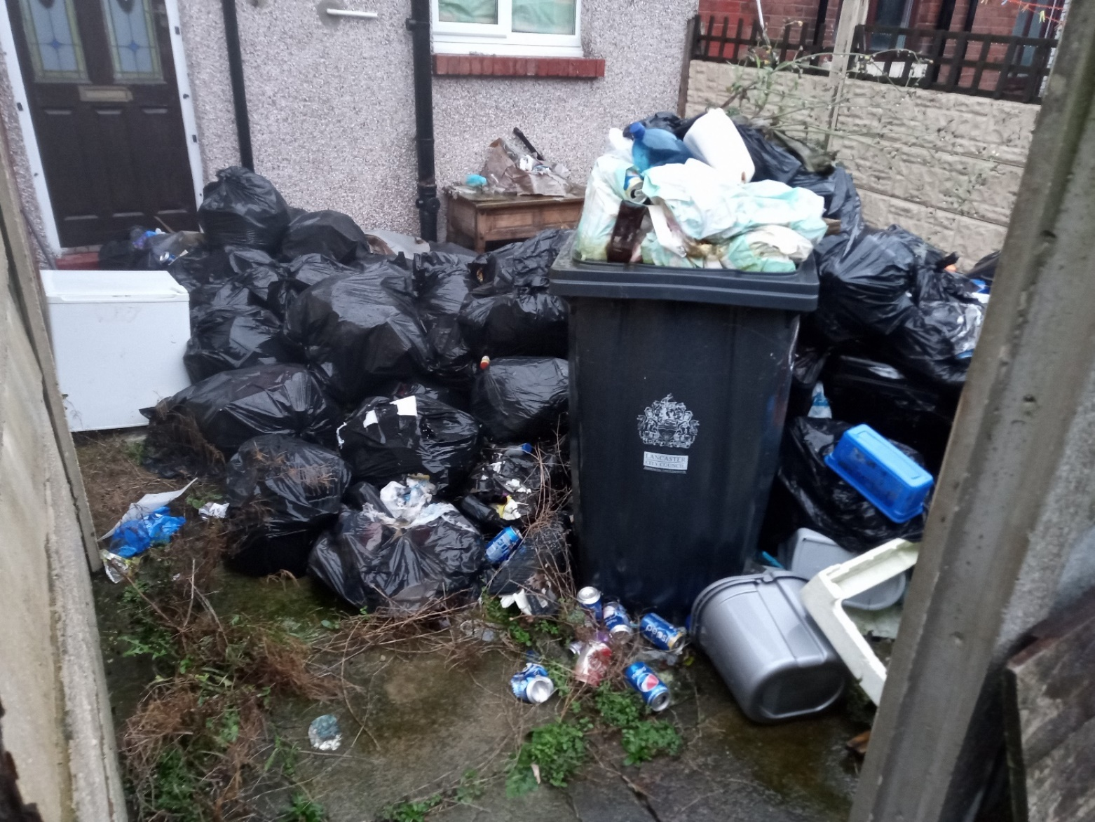
Accumulations of waste

Slide 4
Anti-Social Behaviour, Crime and Policing Act 2014 Section 43 – Power to issue notices
Is it having a detrimental effect on the quality of life of those in the locality;
Is it persistent or continuing in nature; and
Is it unreasonable

Slide 6
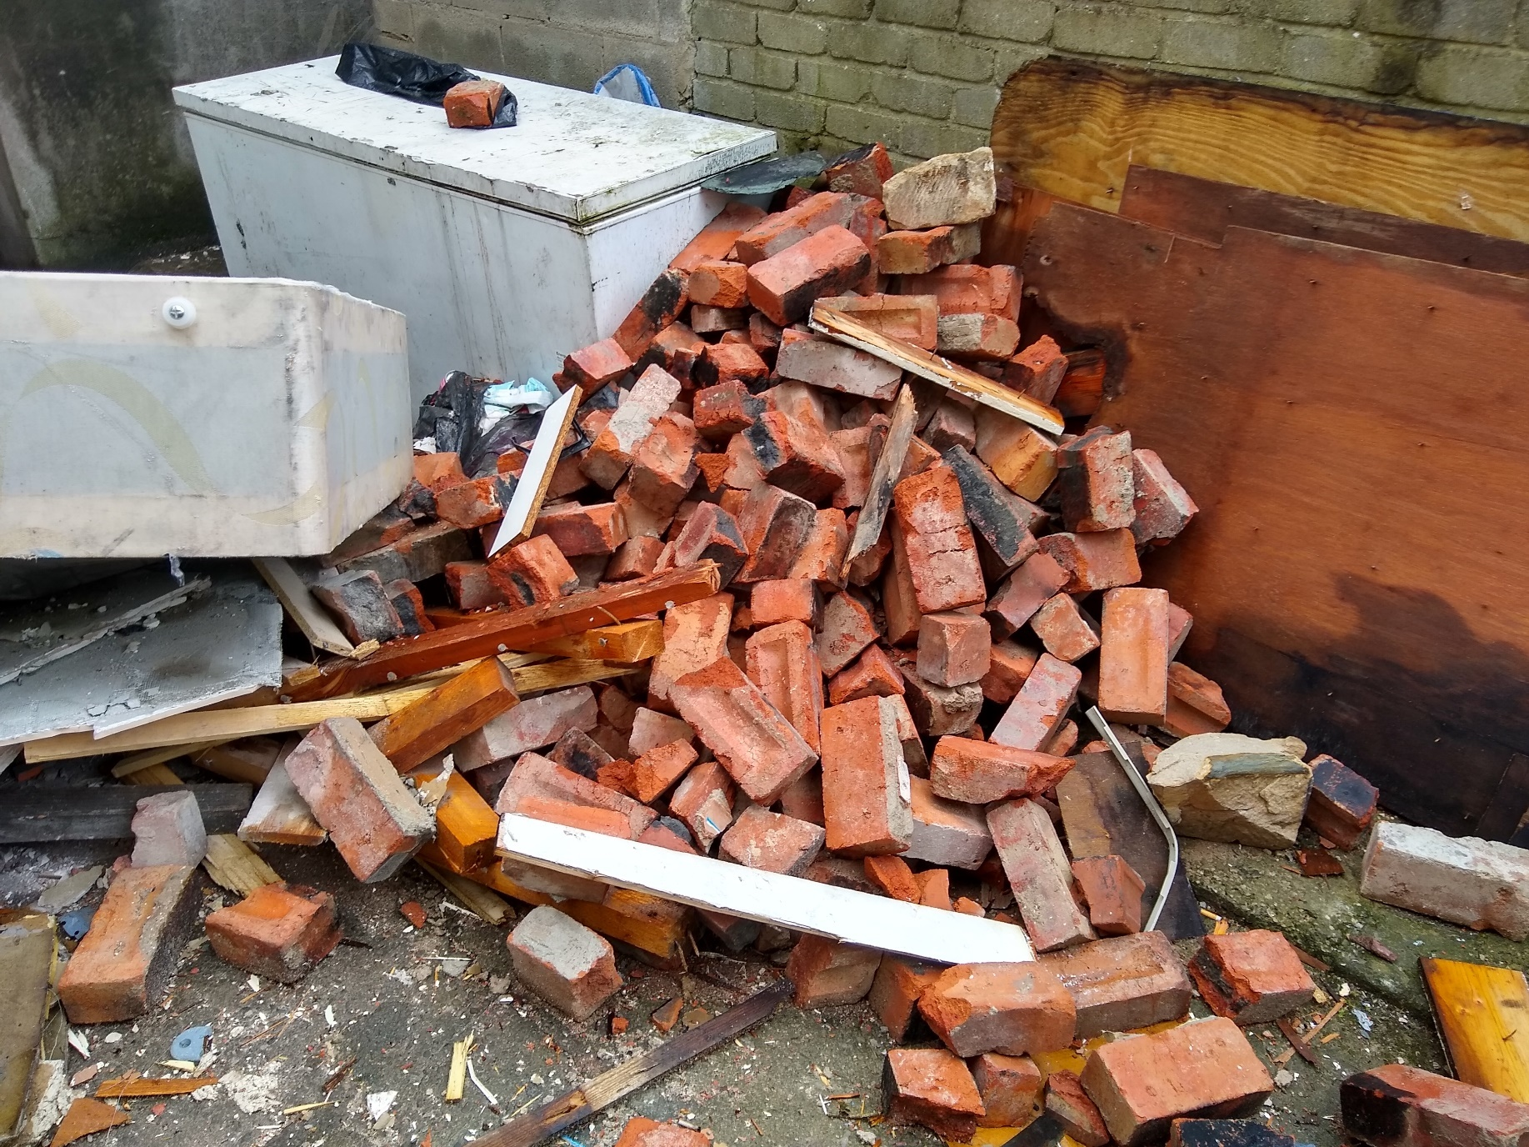

Slide 7
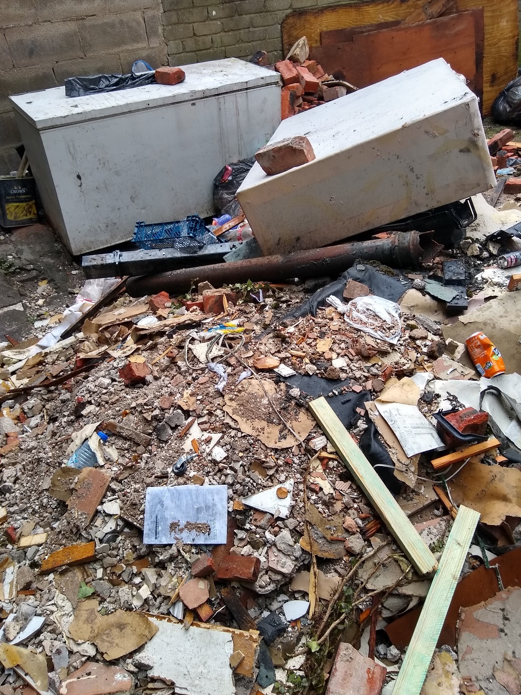
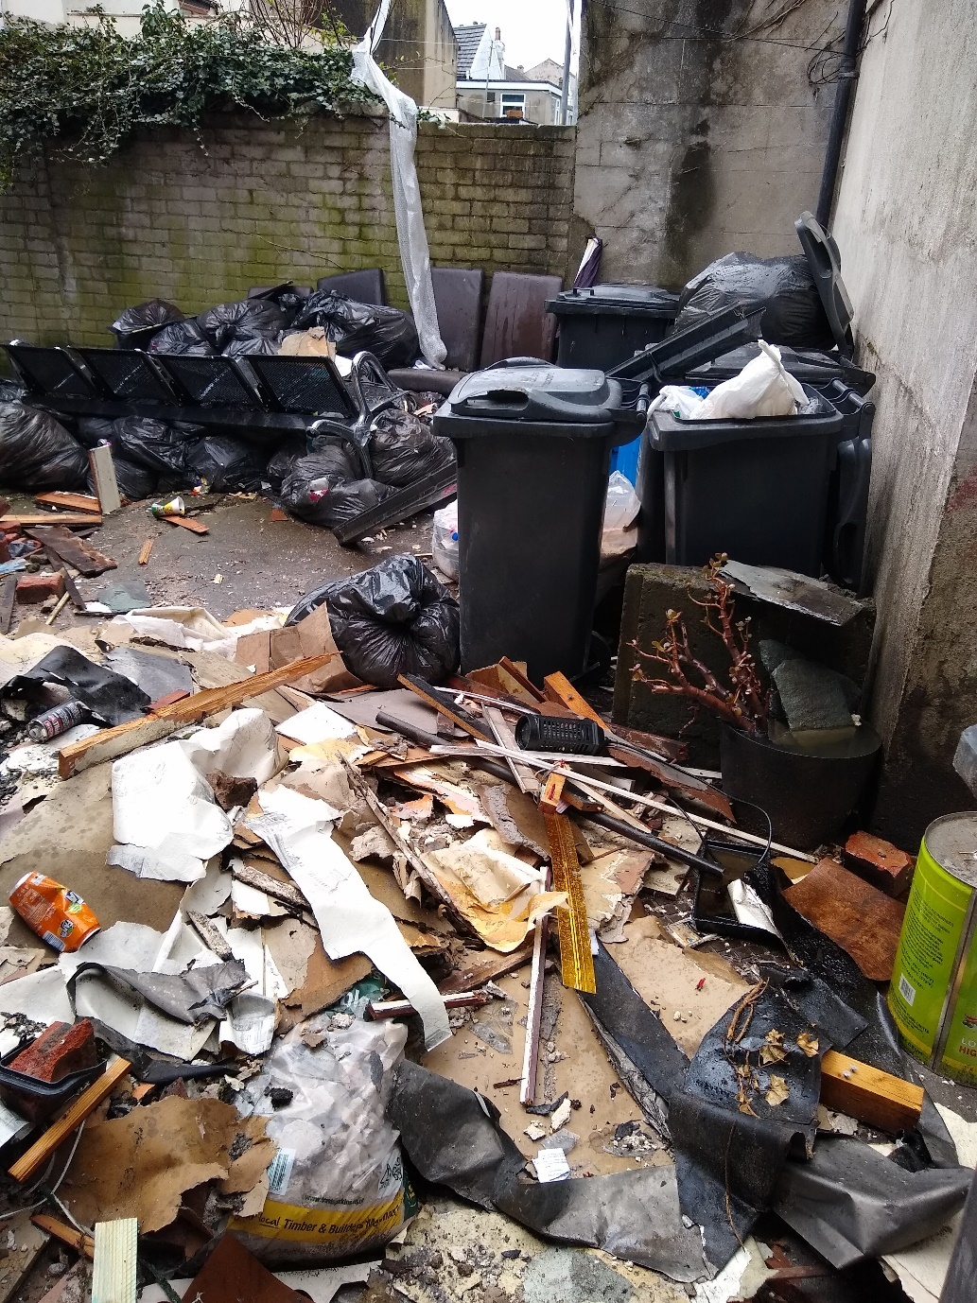

Slide 8
So what can landlords do to reduce the chances of accumulations occurring;
Ensure there are enough receptacles at the property (apply for more if appropriate),
Ensure the tenants are aware of local collection dates and locations,
Ensure tenants are aware of contacting Council for help if needed,
Encourage a good relationship with tenants and be happy to help with problems early,
Write into tenancy agreements waste related clauses.

Slide 9
Anti-social behaviour complaints

Slide 10
Noise nuisance / barking dogs

Slide 11
Dog fouling in yards / gardens

Slide 12
So what can landlords do to reduce the chances of noise / ASB / dog fouling occurring;
Work with Local Authority where appropriate,
Ensure the correct number of tenants are in the house – no overcrowding,
Encourage a good relationship with tenants and be happy to help with problems early,
Write into tenancy agreements noise / ASB / pet related clauses.
Consider the size of the property and outside areas – and whether dogs are appropriate.

