Slide 1
Energy Efficiency (Private Rented Property) (England and Wales) Regulations 2015 (as Amended)
Domestic Minimum Energy Efficiency Standard
(MEES)
Notes:
Introduction

Slide 2
Committed to zero net by 2030
What are Lancaster City Council doing about it?
Reducing building emissions throughout Council owned buildings
Salt ayre
De-carbonise LCC’s vehicle fleet
New 27 tonne electric bin wagon
Made a commitment to make Housing stock C by 2030
Retrofit Officer

Slide 4
Why does it matter?
Cold related ill health including respiratory and cardiovascular disease
Behaviour related ill health, stress, poor diet, metal health and well being
Increase in the value of the property
Damp and mould
Can be cheap effective methods
Better housing can lead to a more stable local environment

Slide 5
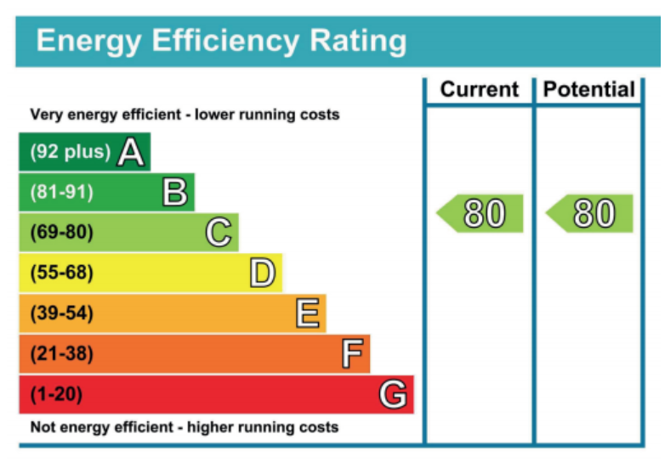
Raising the standards of the private rented sector

Slide 6
What are the Minimum Standards?
From April 2020, if your property is :
Let on a domestic tenancy (eg assured or regulated tenancy)
Legally required to have an EPC
It must have an EPC rating of E and above, unless a valid exemption is in place.
Landlords are required to spend a maximum of £3,500 (including VAT) on energy efficiency improvements

Slide 7
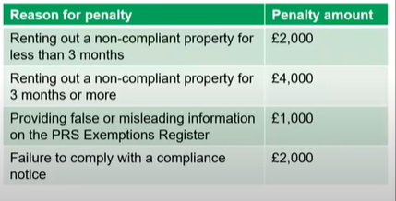
Types of exemptions
Enforcement proceedings
All relevant improvements
High cost
Wall insulations exemption
Third party
Property devaluation
Consent
Recently become a Landlord
1. Compliance notice
2. Financial penalty (up to £5,000) issued by Local Authority

Slide 8
Proposed changes April 2025
Raising the minimum efficiency standard to C
Increasing the cost cap from £3,500 to £10,000
Increasing the levels of fines LA’s can issue from £5,000 to £30,000
Strengthening enforcement by placing a requirement on letting agents only to let properties which are compliant with MEES
Requiring a new EPC when the current one runs out

