Slide 1
LANCASTER CITY COUNCIL
HOUSING STANDARDS

Slide 2
CORPORATE PRIORITY
To provide a safe, secure and warm home for everyone in our district
Housing standards
Home Improvement Agency
Housing Options

Slide 3
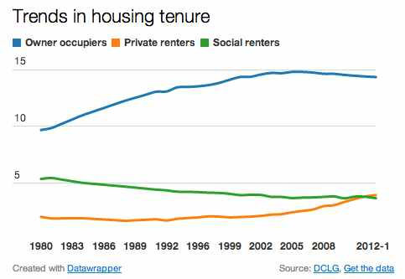
PRIVATE RENTED SECTOR

Slide 4
LOCAL AUTHORITY MUST
KEEP THE HOUSING CONDITIONS IN THEIR AREA UNDER REVIEW
INSPECT PROPERTIES TO DETERMINE WHETHER ANY CATEGORY 1 OR 2 HAZARDS EXIST
TAKE APPROPRIATE ENFORCEMENT ACTION IF THEY CONSIDER CATEGORY 1 HAZARDS EXIST
ADMINISTER A MANDATORY LICENSING SCHEEM FOR QUALIFYING HMOS.

Slide 5
HOUSING HEALTH AND RATING SYSTEM

Slide 6
HOUSING ACT 2004
ANY RESIDENTIAL PREMISES SHOULD PROVIDE A SAFE AND HEALTHY ENVIRONMENT FOR ANY POTENTIAL OCCUPIER OR VISITOR.

Slide 7
DAMP AND MOULD GROWTH

Slide 8
EXCESS COLD

Slide 9
ELECTRICAL

Slide 10
FIRE

Slide 11
FIRE
I have listed below common areas of concerns found in local premises:
Fire detection heads missing
Fire detection heads covered up
Fire door closers removed
Fire doors wedged open
Fire escape windows locked shut
Means of escape blocked by furniture and occupants goods
Candles and lanterns having been recently used

Slide 12
MANAGEMENT
The Management of Houses in Multiple Occupation (England) Regulations 2006
The Licensing and Management of Houses in Multiple Occupation (Additional Provisions) (England) Regulations 2007

Slide 13
FIRE

Slide 14
RUBBISH

Slide 15
ACCREDITED PROPERTY SCHEME

Slide 16
LICENSING OF HOUSES IN MULIPLE OCCUPATION
HMO’s THAT HAVE THREE OR MORE STOREYS AND ARE OCCUPIED BY FIVE OR MORE TENANTS LIVING AS MORE THAN ONE HOUSHOELD AND SHARING FACILITIES MUST HAVE A LICENCE FROM THE LOCAL AUTHROITY TO OPERATE.

Slide 17
ITS PURPOSE IS TO ENSURE:
landlords of HMOs are fit and proper people, or employ managers who are
each HMO is suitable for occupation by the number of people allowed under the licence
the standard of management of the HMO is adequate
high risk HMOs can be identified and targeted for improvement.

Slide 18
PRIORITIES FOR 2014/15
REMOVAL OF ALL CATEGORY 1 HAZARDS
CONCENTRATE ON EXCESS COLD AND FUEL POVERTY
REDUCTION IN SLIPS, TRIPS AND FALLS
IMPROVEMENTS TO FIRE SAFETY
PROMOTE GOOD MANAGEMENT
WORK WITH RESIDENTS OF PARK HOMES

Slide 19
PARTNERSHIP WORKING
FIRE SERVICE
PUBLIC HEALTH
HEALTH AUTHORITY
POLICE SERVICE
TRADING STANDARDS

Slide 20
FURTHER INFORMATION
SHOULD YOU WISH TO SEE MORE INFORMATION PLEASE CONTACT PRIVATE HOUSING ON 01524 582257 OR LOOK AT THE COUNCIL’S WEBSITE:
www.lancaster.gov.uk.

